Slide 1
CIS 490H/590J Edge Computing
Multi-Layer Computing: End Devices
Winter 2022
Prof. Zheng Song
zhesong@umich.edu

Slide 2
Outline
End Devices (data producers):
Common features
Raspberry Pi, Arduino, ESP32, Jetson TX2 NX
mobile devices
Vehicle as a mobile sensor
IoT Gateway
IoT Communication Protocols
BLE, Zigbee
MQTT, coAP, websocket
IoT applications:
indoor localization
Personal sensing
crowdsensing
wireless sensor network

Slide 3
IoT devices
Less powerful than computers
Embedded operating systems (or without OS)
Equipped with more wireless communication modules
WiFi, BLE, Cellular
RFID, Zigbee, Lora (long range, low rate)
Work with Sensors and controllers
Heterogeneity
Some powered by battery
Sensitive to energy efficiency
Low energy consumption (3~15W)
PC: 60~300 Watts
Laptop: 20~100 Watts
Server: 500 ~ 1200 Watts

Slide 4
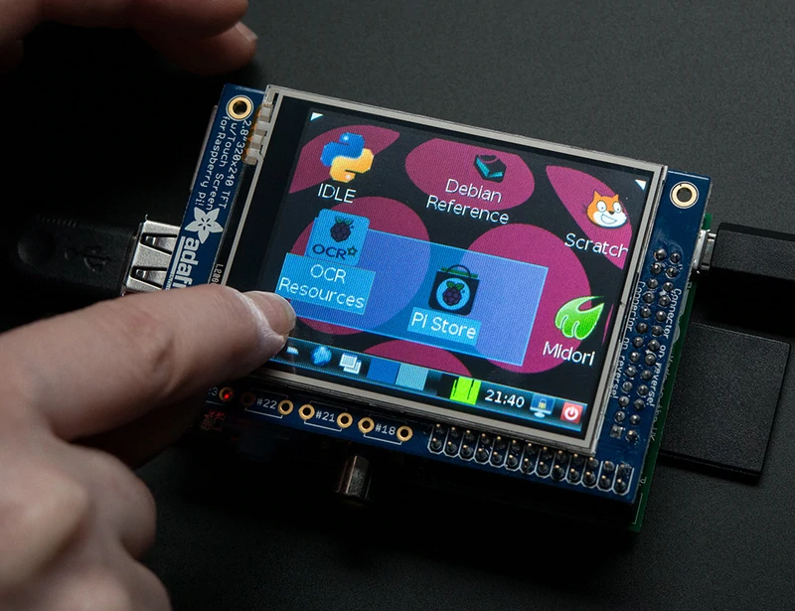
Raspberry Pi
Affordable credit-card sized computer
Plugs into a computer monitor or TV
Uses standard keyboard and mouse
Can browse the internet and play HD video
Can also interact with the outside world!

Slide 5
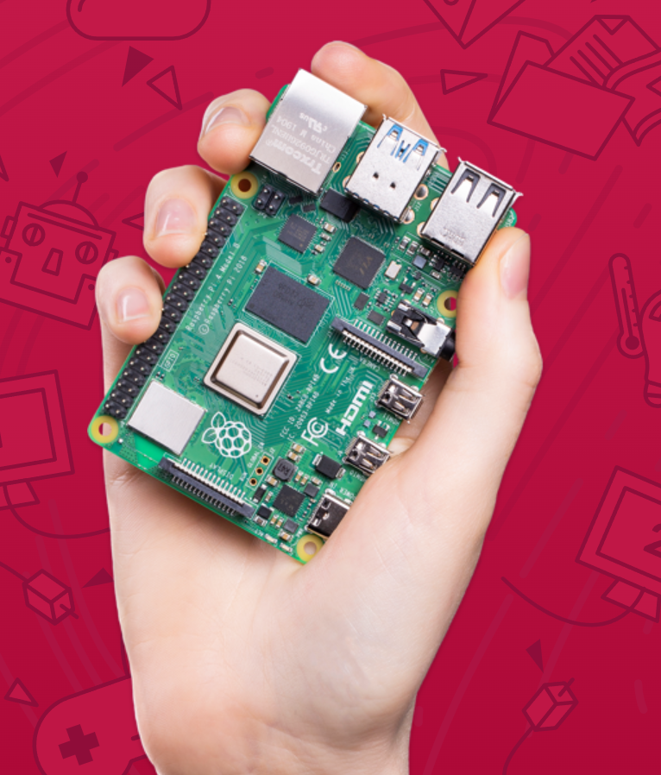
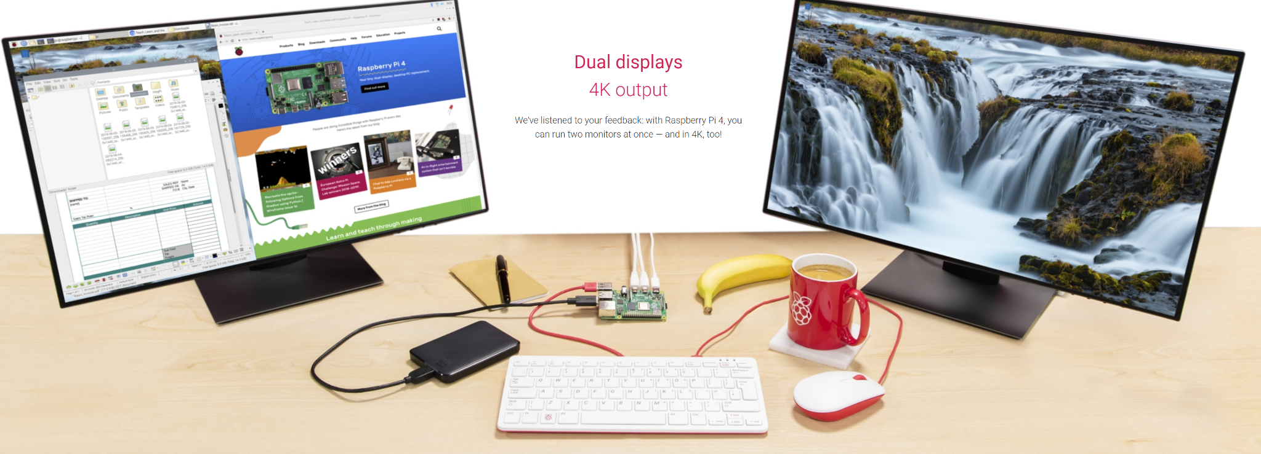
Models: Pi 4B
Broadcom BCM2711, Quad core Cortex-A72 (ARM v8) 64-bit SoC @ 1.5GHz
2GB, 4GB or 8GB LPDDR4-3200 SDRAM (depending on model)
2.4 GHz and 5.0 GHz IEEE 802.11ac wireless
Bluetooth 5.0, BLE Gigabit Ethernet
2 USB 3.0 ports; 2 USB 2.0 ports.
Raspberry Pi standard 40 pin GPIO header
2 × micro-HDMI ports (up to 4kp60 supported)
Vulkan 1.0 Micro-SD card slot
5V DC via USB-C connector
$40 - $100

Slide 6
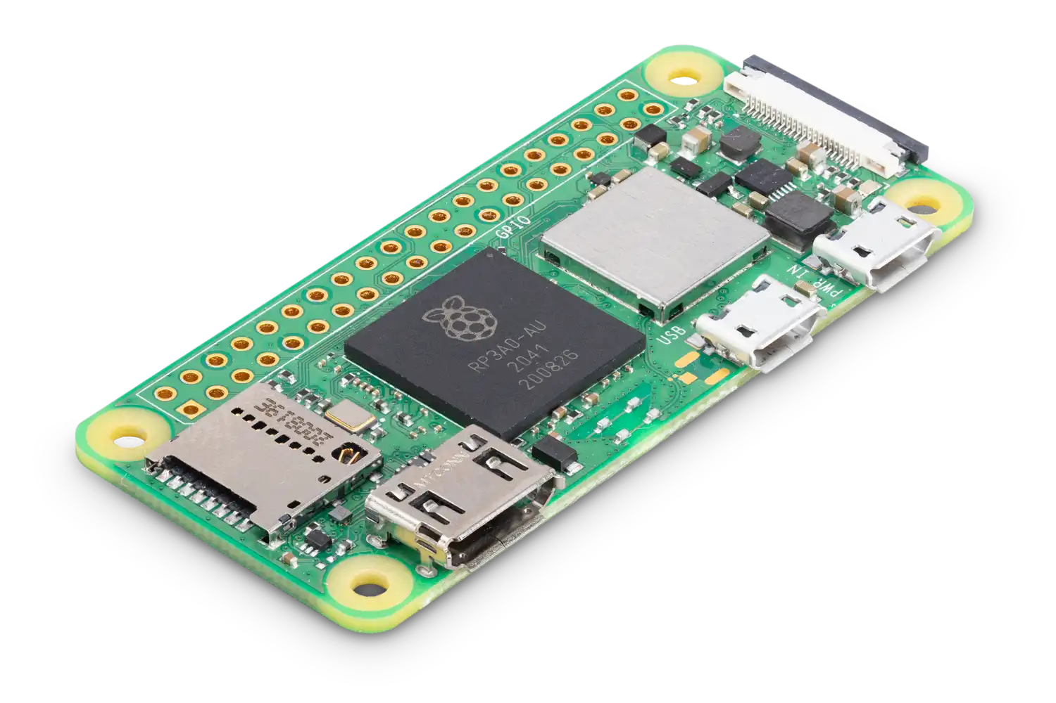
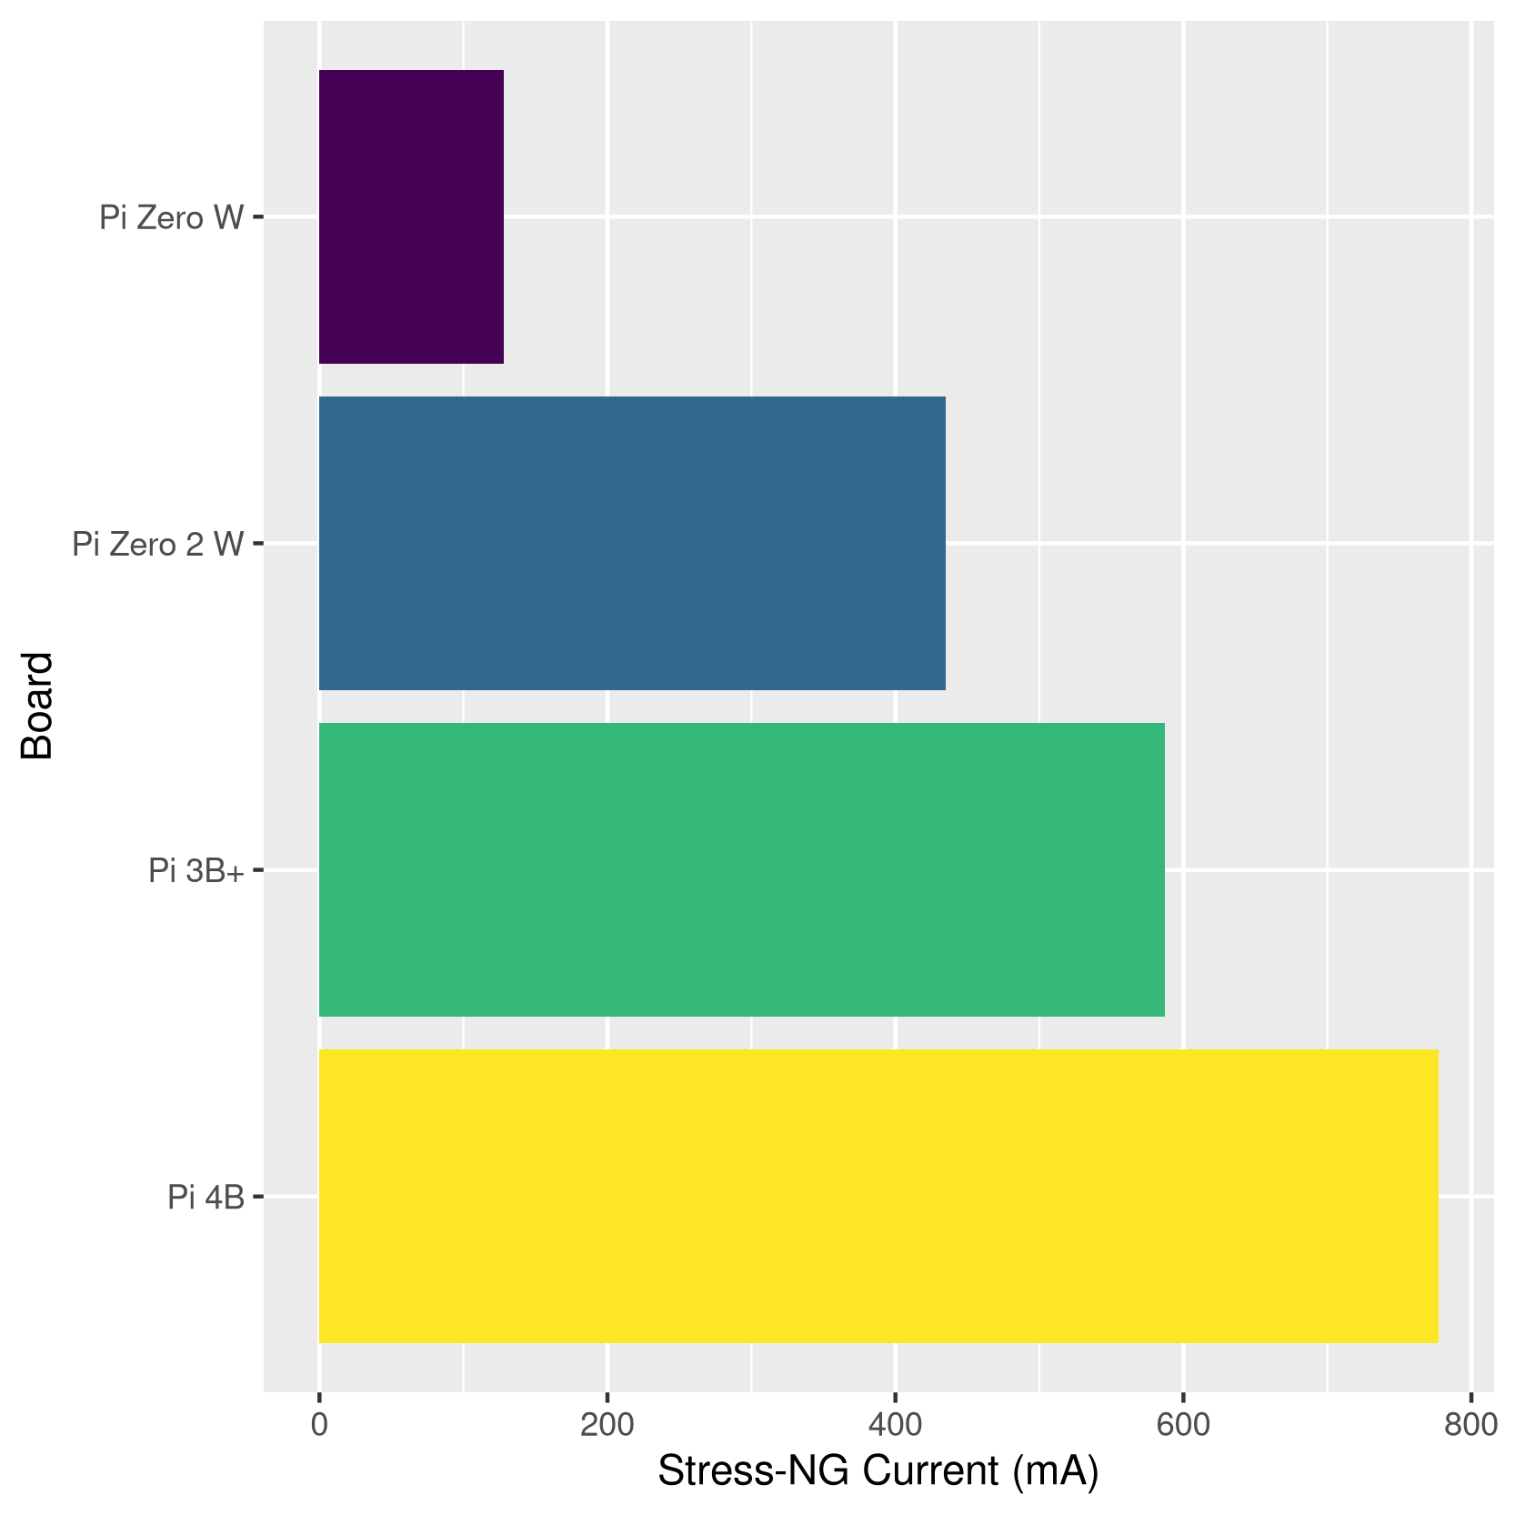
Models: Pi Zero 2 W
1GHz quad-core 64-bit Arm Cortex-A53 CPU
512MB SDRAM
2.4GHz 802.11 b/g/n wireless LAN
Bluetooth 4.2, Bluetooth Low Energy (BLE), onboard antenna
Mini HDMI port and micro USB On-The-Go (OTG) port
microSD card slot
CSI-2 camera connector
HAT-compatible 40-pin header footprint (unpopulated)
Micro USB power
65mm x 30mm
$10

Slide 7
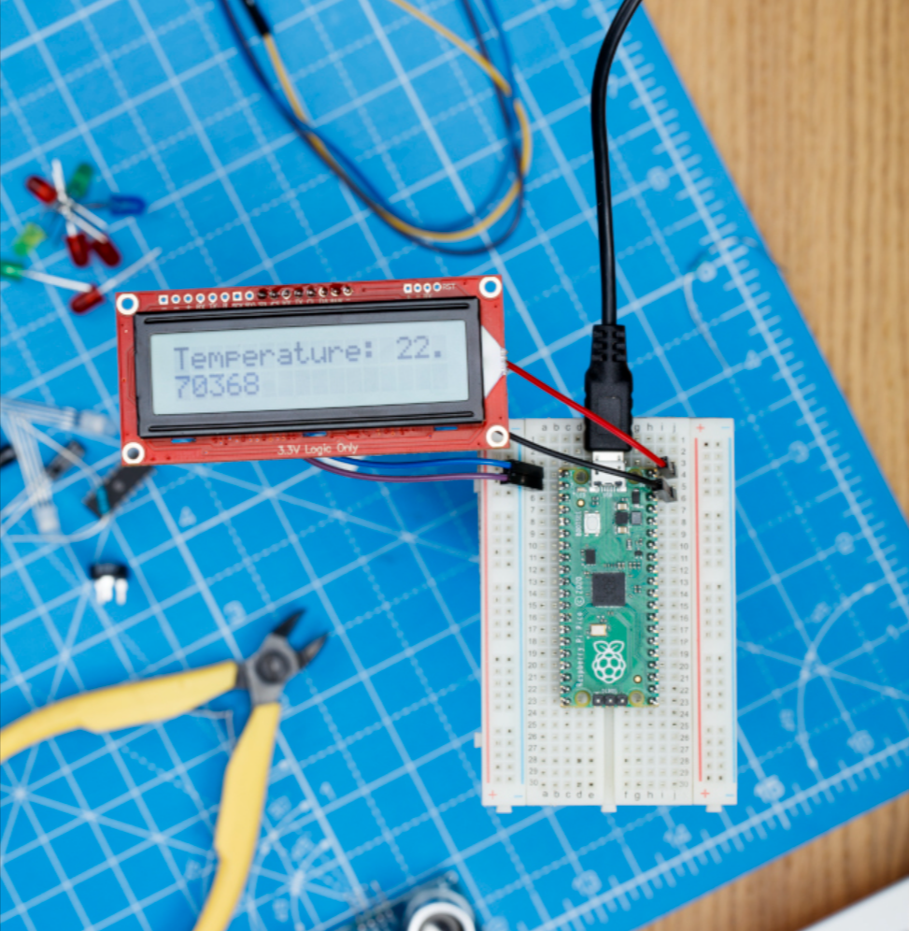
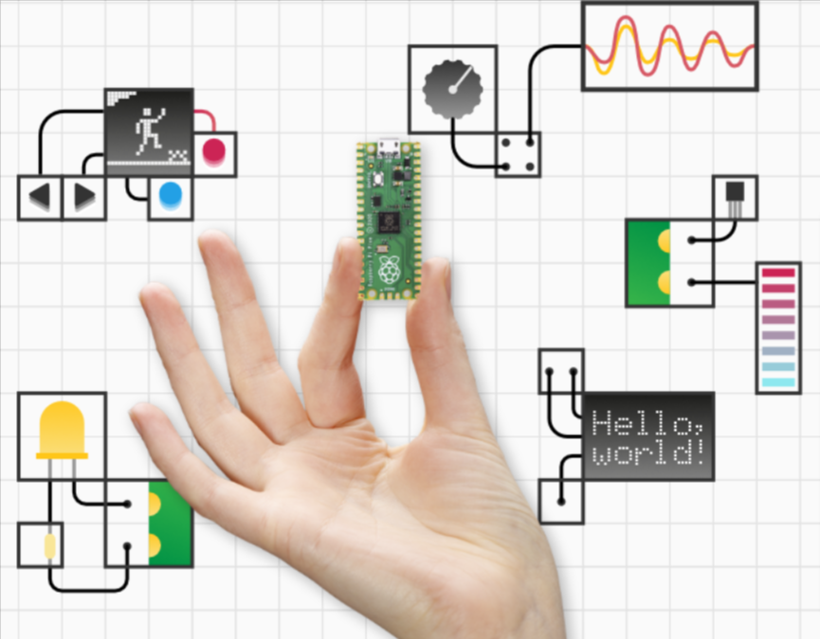
Models: Pi Pico
51 mm × 21 mm
Dual-core Arm Cortex-M0+ processor, flexible clock running up to 133 MHz
264KB on-chip SRAM
2MB on-board QSPI Flash
26 multifunction GPIO pins
1 × USB 1.1 controller
Micropython Programming Platform (Thonny)
Firmware
https://projects.raspberrypi.org/en/projects/getting-started-with-the-pico/

Slide 8
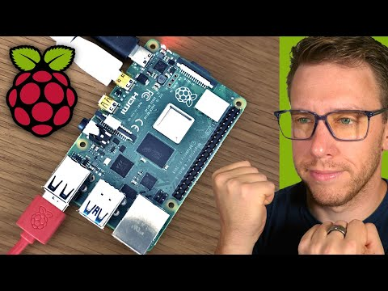
How to setup a Raspberry Pi
You will need:
keyboard/mouse
HDMI, monitor
SD Card
Around 1 hour of time

Slide 9
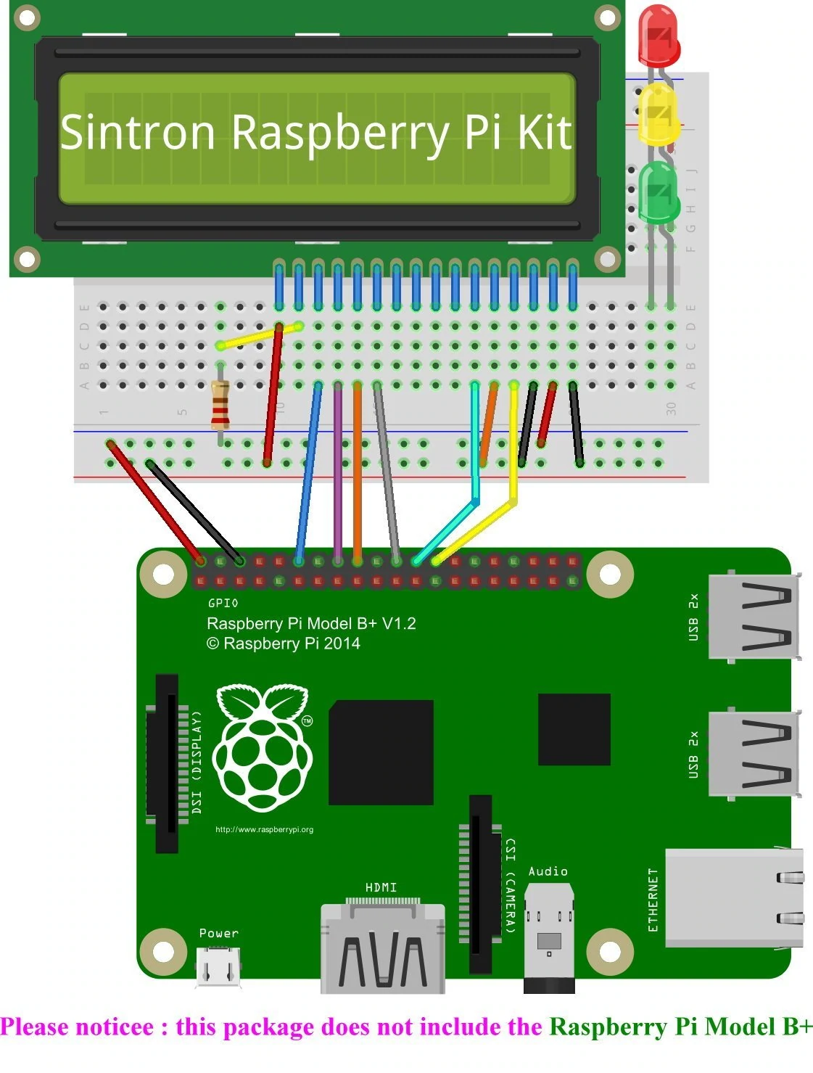

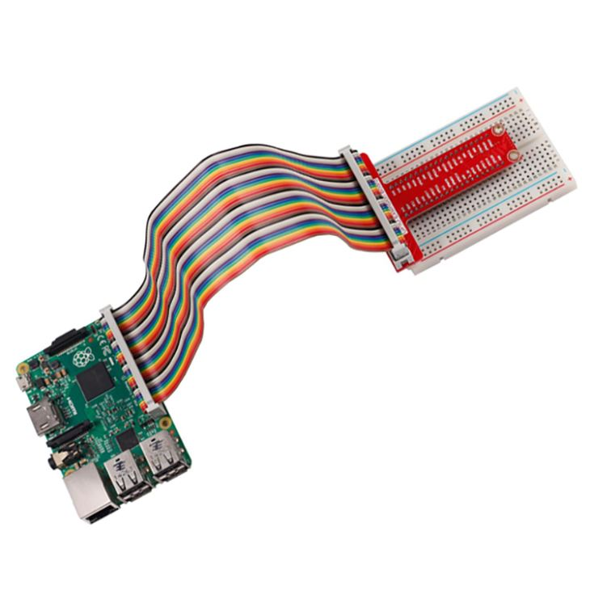
How to connect to sensors?
GPIO: General-Purpose Input/Output

Slide 10
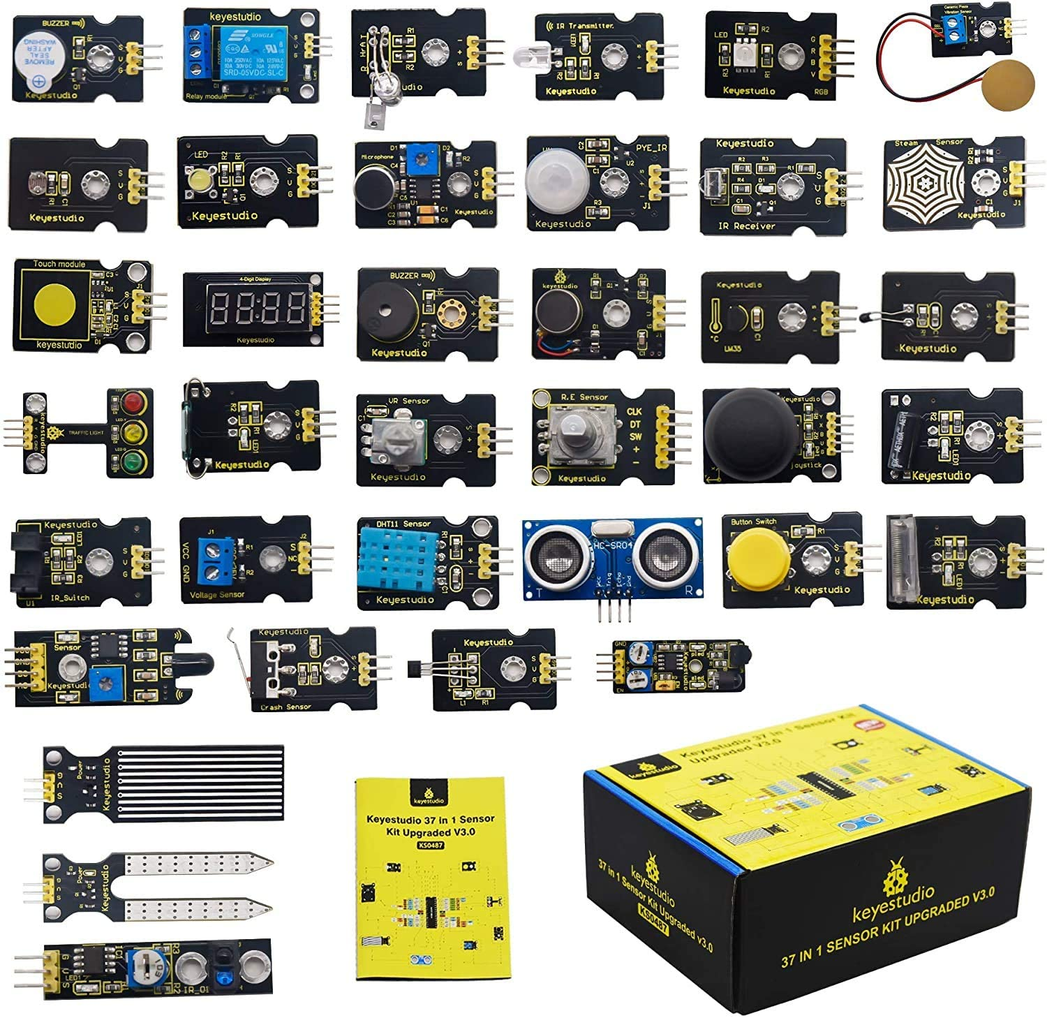
Raspberry PI Sensors
Flame sensor
Temperature and humidity
Moisture sensor
Water level sensor
Motion sensor
Collision sensor
Camera
Ultrasonic sensor
Sound sensor
…

Slide 11
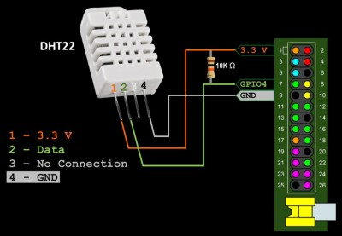
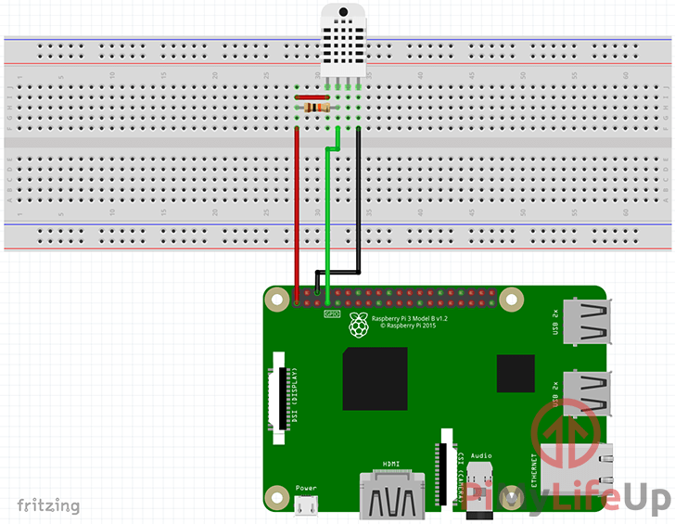
How to use these sensors?
DHT-22 as an example:
GPIO expansion board
Reference: https://pimylifeup.com/raspberry-pi-humidity-sensor-dht22/
Notes:
resistance

Slide 12
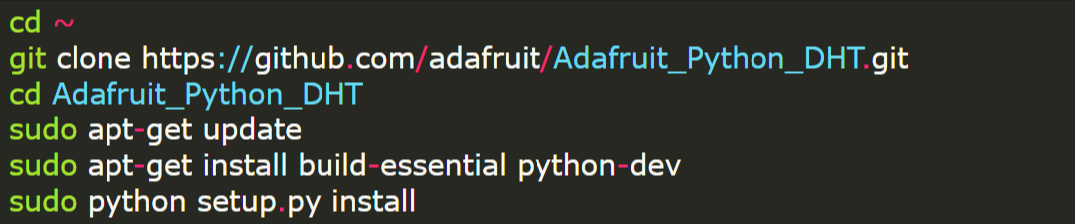
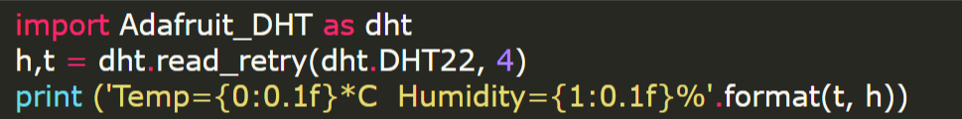
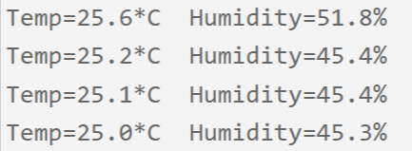
How to use these sensors?
https://www.youtube.com/watch?v=IHTnU1T8ETk
DHT-22 as an example:
https://github.com/adafruit/Adafruit_Python_DHT
Install the library
Invoke the API:
output:

Slide 13
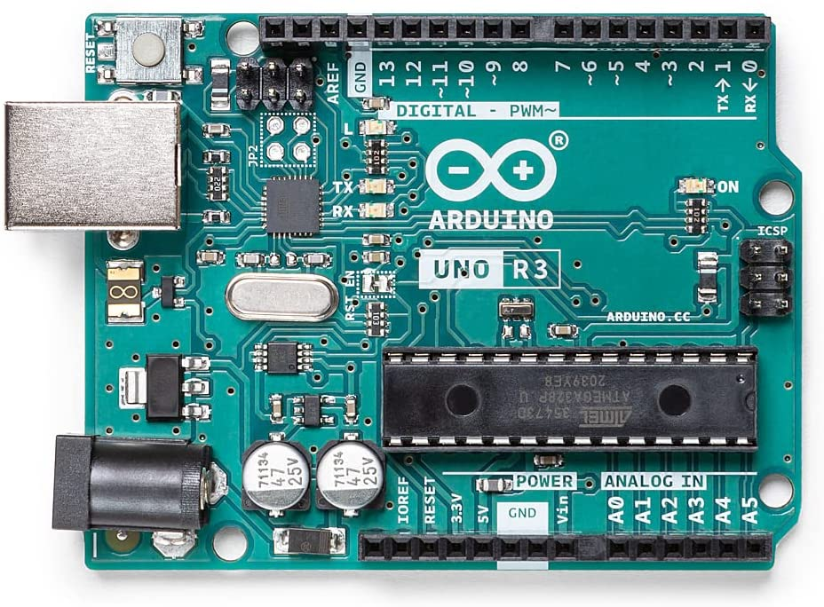
Arduino
Raspberry Pi ⇔ Arduino
Single Board Computing | Microcontroller development board
linux based OS | No OS
Multiple tasks | Single task
High level programming languages | C or C++
Built-in wireless modules | Addon wireless modules

Slide 14
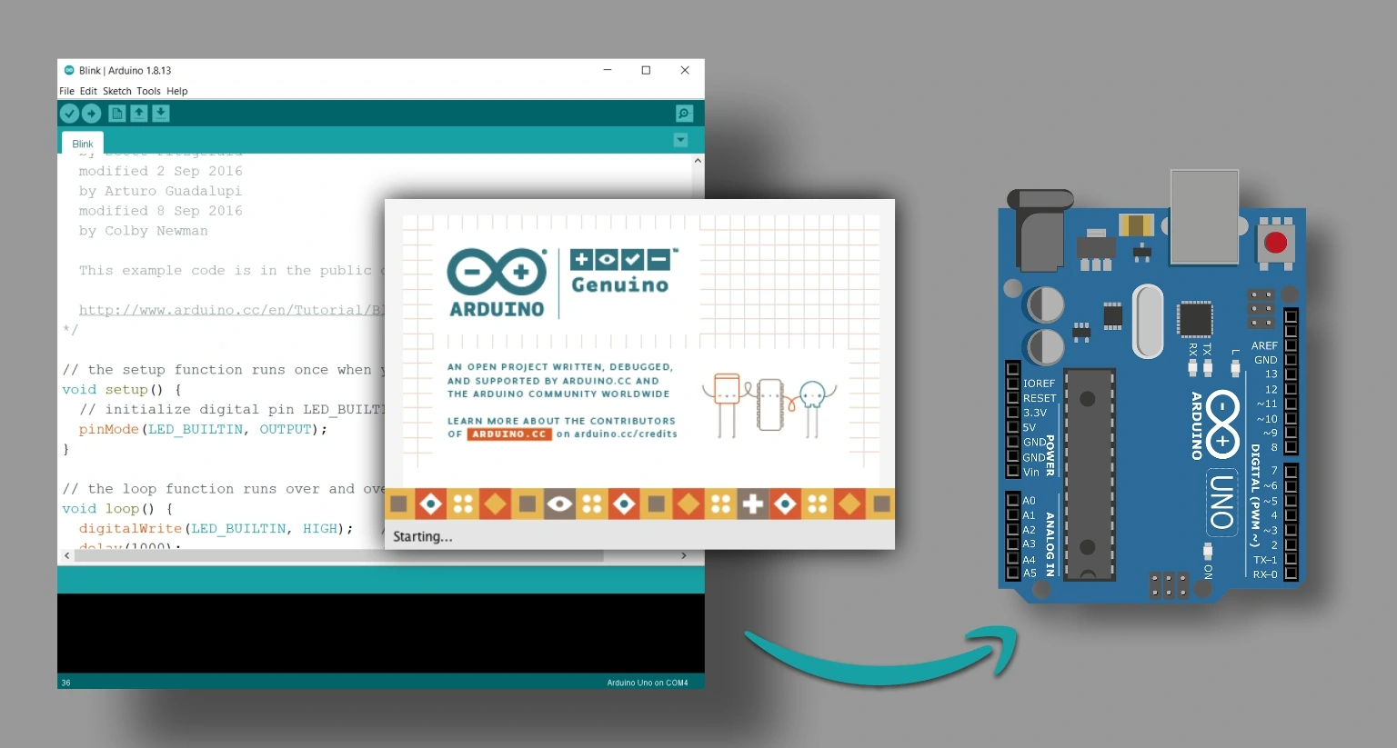
Arduino IDE
Connect Arduino Uno to your computer
Install and launch Arduino IDE
Create your project (open sample projects: Blink Arduino LED)
Select your arduino board in the IDE
Upload your program to the board
Run it!
Cross-compile: compiling code for one computer system on a different system
Reference: https://www.techtonions.com/getting-familiar-with-arduino-ide/

Slide 15
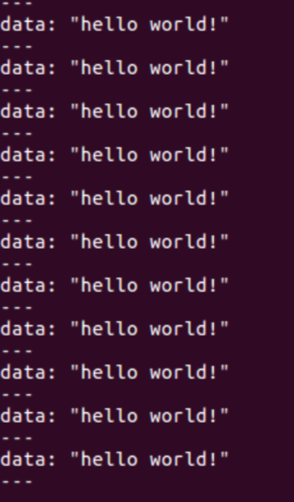
Arduino + ROS
1 /*
2 * rosserial Publisher Example
3 * Prints "hello world!"
4 */
5
6
7 //#define USE_USBCON
8
9 #include <ros.h>
10 #include <std_msgs/String.h>
11
12 ros::NodeHandle nh;
13
14 std_msgs::String str_msg;
15 ros::Publisher chatter("chatter", &str_msg);
16
17 char hello[13] = "hello world!";
18
19 void setup()
20 {
21 nh.initNode();
22 nh.advertise(chatter);
23 }
24
25 void loop()
26 {
27 str_msg.data = hello;
28 chatter.publish( &str_msg );
29 nh.spinOnce();
30 delay(1000);
31 }
ROS (Robot Operating System)
http://wiki.ros.org/rosserial_arduino/Tutorials/Arduino%20IDE%20Setup

Slide 16
ESP32
Hardware Updated Version of Arduino
Similar software (many Arduino applications can run on ESP32)
More built-in features (WiFi, BLE, sensors, WiFi mesh, Ethernet)

Slide 17
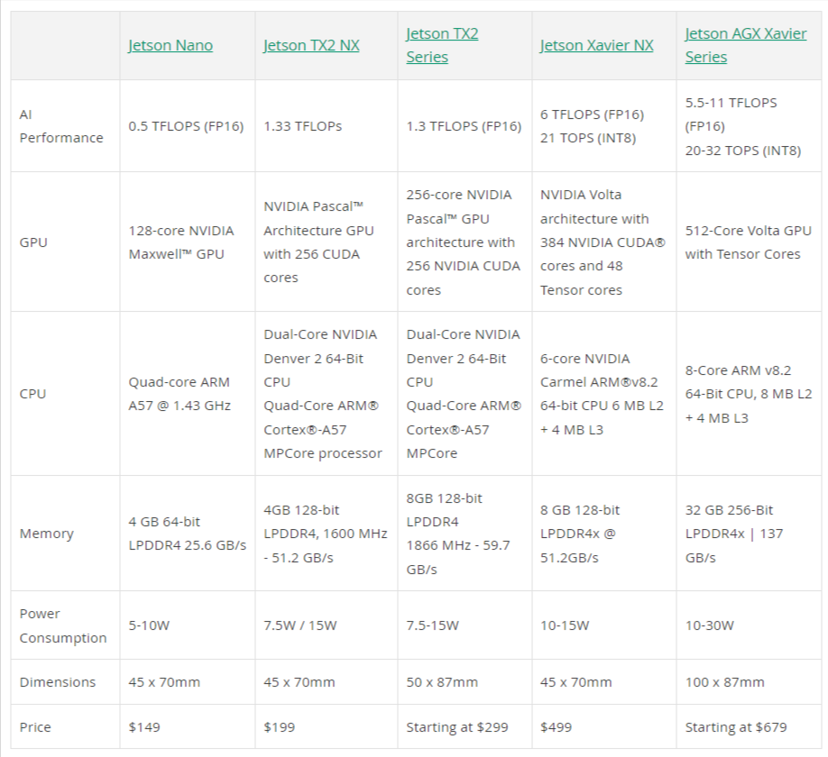
Jetson TX2
OS: Linux (core: Ubuntu 18.04)
HW: GPU
First choice when you run deep learning tasks at the edge

Slide 18
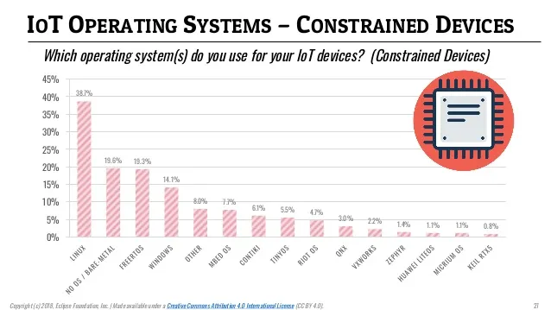
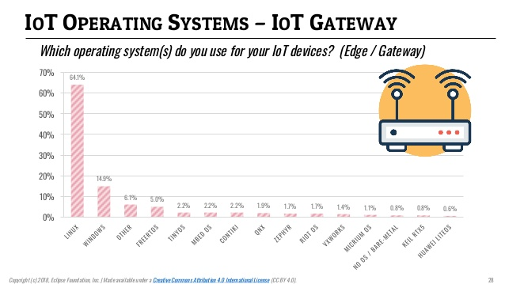
OS for IoT Devices
Linux: 38.7% for constrained devices, 54% for IoT Gateway
IoT OS: FreeRTOS, TinyOS, etc.

Slide 19
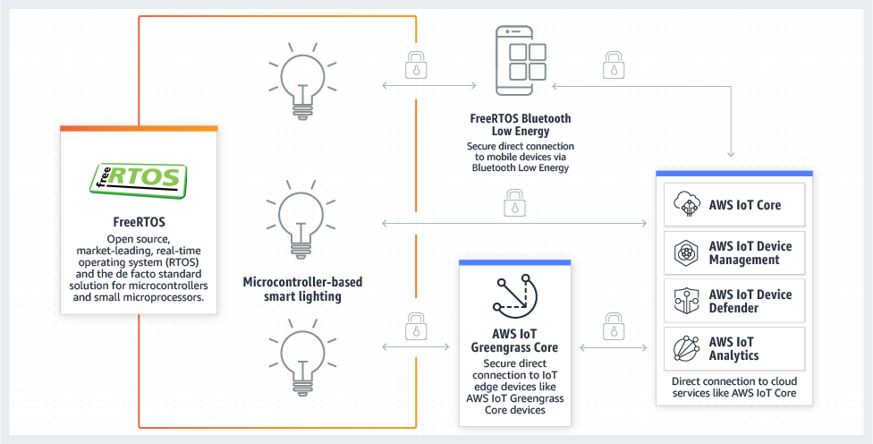
FreeRTOS
Amazon FreeRTOS: open-source FreeRTOS kernel + libraries to securely connect devices to AWS cloud services.

Slide 20
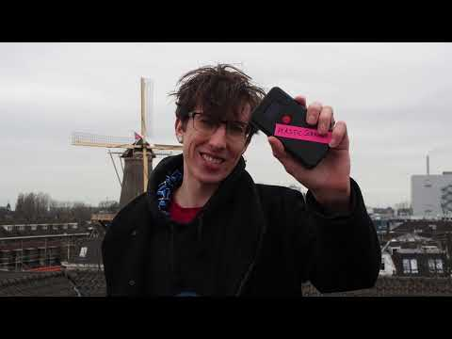
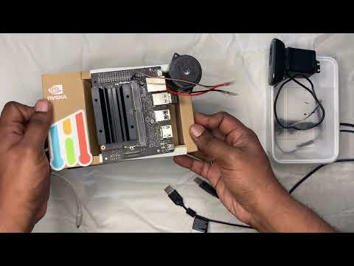
Sample Projects
Plastic Scanner
near-infrared spectroscopy
Pedestrian Detection
https://create.arduino.cc/projecthub

Slide 21
Mobile Devices
Mobile Phones
Fitbit / Smart Watch
Smart Glasses
Other wearable devices?
Rings
Jacket

Slide 22
Mobile Phones
Mobile phones in 2022 is more powerful than many servers in 2012
Higher CPU/GPU frequency (A15 Bionic system on a chip, 6 cores 3.2 GHz)
More memory (LPDDR4x) 6GB RAM (random access memory)
512GB SSD Storage
Higher network connectivity and speed
NFC, BLE, WiFi, Low Earth Orbit Satellite Communication (Rumor)
5G: 2Gbps
Limitation: battery powered

Slide 23
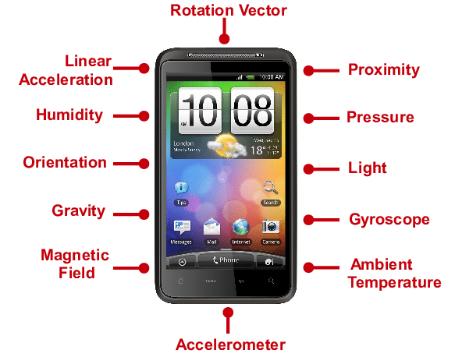
Mobile Phones
Most Frequently Used Sensors:
GPS
Microphone
Cameras (front, rear)
WiFi/BLE
Accelerometer
Orientation sensor (Gyroscope)
Magnetic sensor
Light/Proximity
Screen

Slide 24
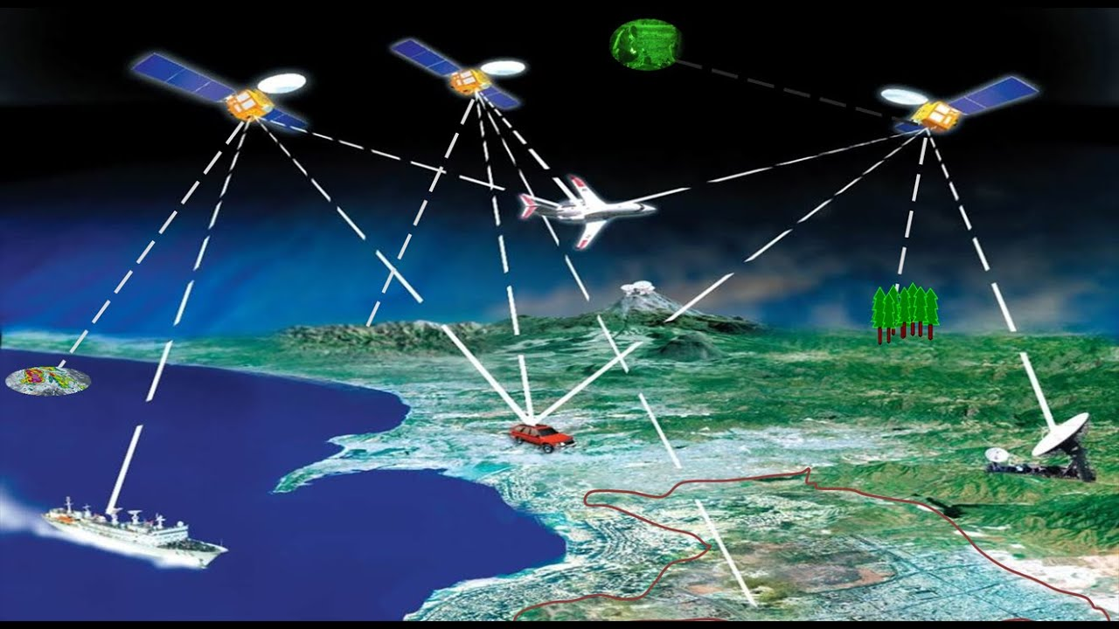
Mobile Phone Sensors
GPS:
Receive signal from satellite (cannot be used in most indoor environments)
Accuracy: 30 cm to 10 meters (w/ and w/o ground station)
You don’t need to pay for its usage!

Slide 25
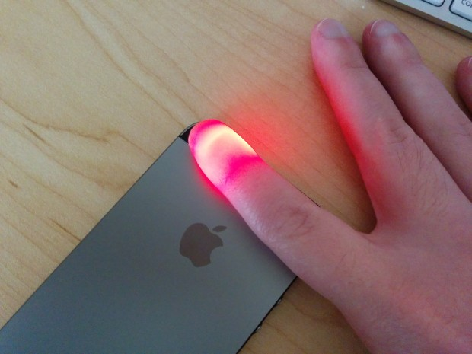
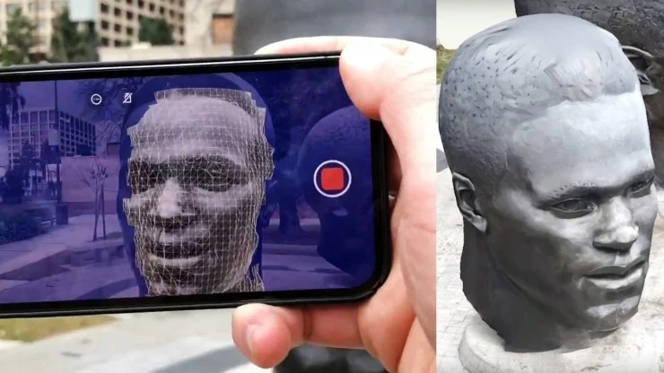
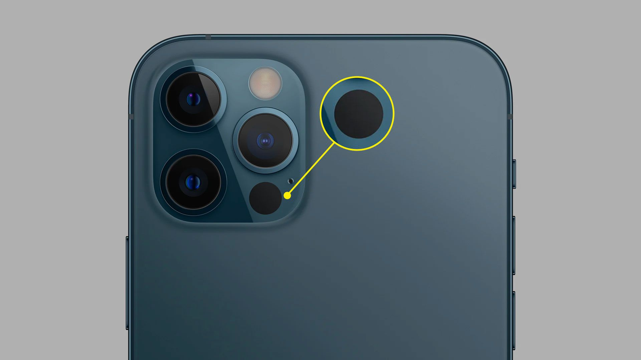
Mobile Phone Sensors
Flashlight
Camera: 12 MP, with flashlight and lidar
Lidar: Light Detection and Ranging, depth information
Flashlight: heart rate detection
Lidar
Notes:
Bump blood into the vessel

Slide 26
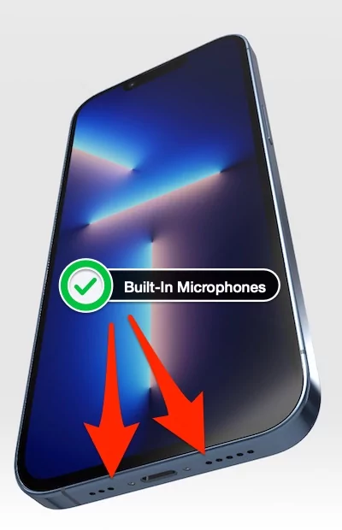
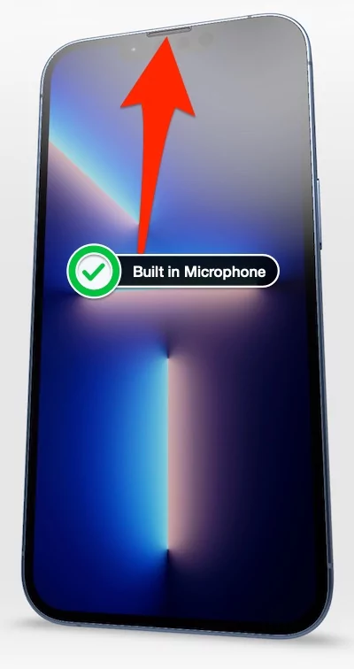
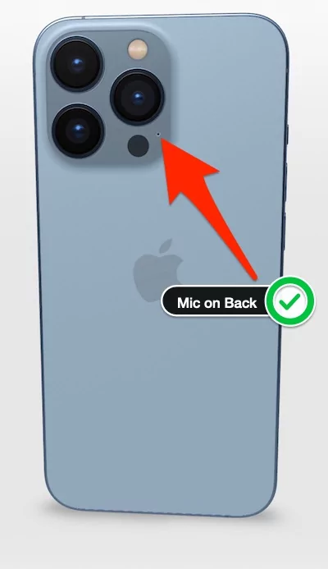
Mobile Phone Sensors
Built-in Microphone and Speakers:
send/ hear sounds that we human cannot hear (20 - 20K Hz)
location differences in microphones can be used for object detection

Slide 27
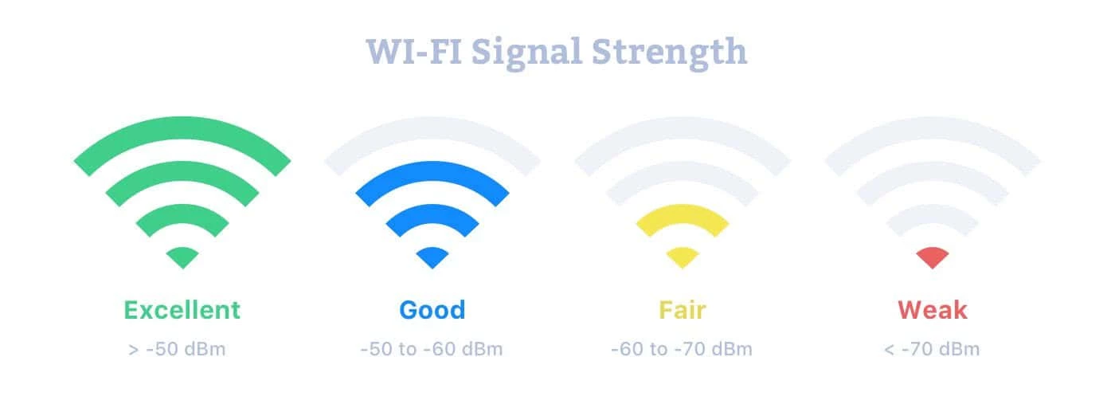
Mobile Phone Sensors
WiFi/BLE:
RSSI (received signal strength indicator)
Related to distance between the receiver and the sender
Related to the obstacles in the environment
BSS_ID, UU_ID
BSS_ID: base station related
UU_ID: application related

Slide 28
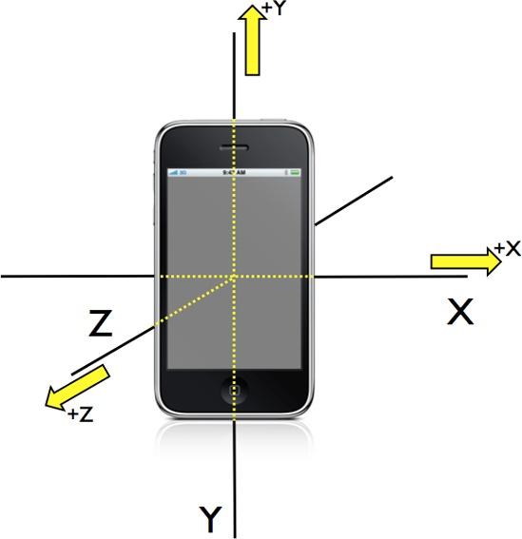
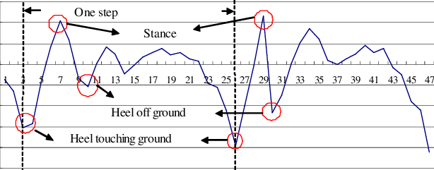
Mobile Phone Sensors
Accelerometer: acceleration along three axes of the phone
Counting steps

Slide 29
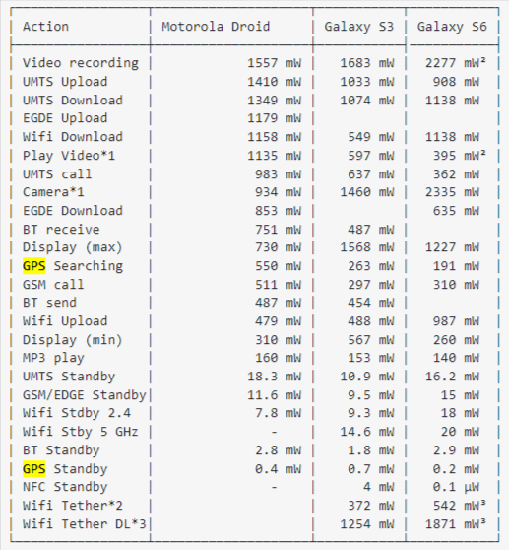
Mobile Phone Power Consumption
Video Recording > 3G WiFi Data Transmission > WiFi > GPS > Bluetooth
ZiFi: Wireless LAN discovery via ZigBee interference signatures (MOBICOM’10)

Slide 30
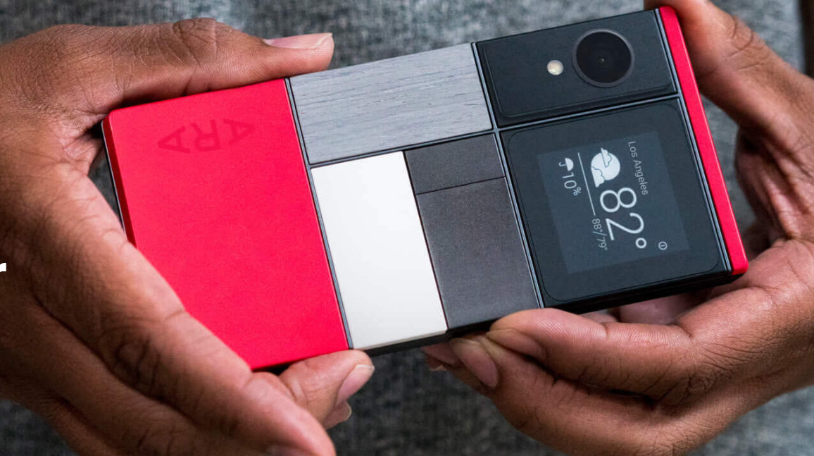
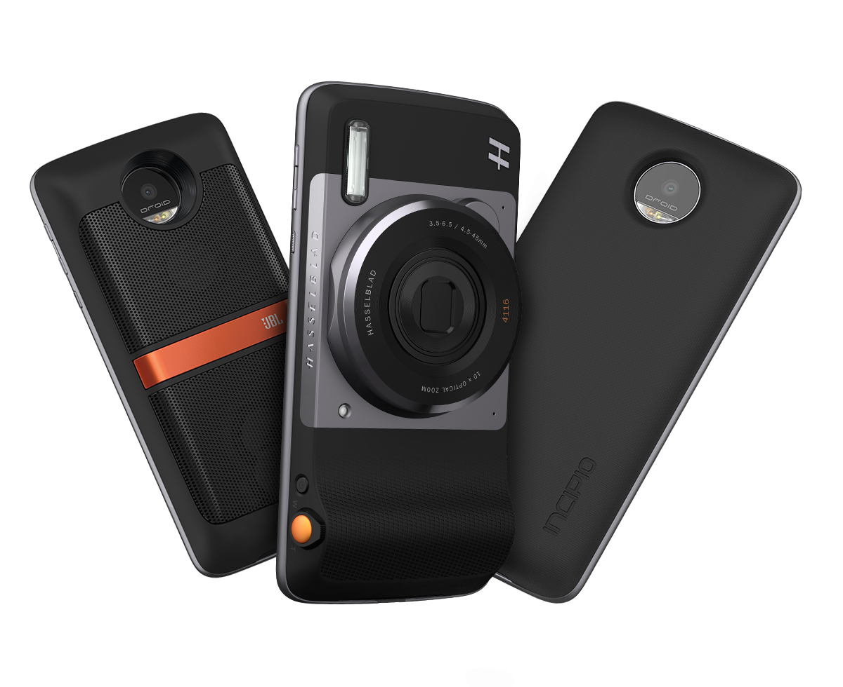
Modular Phones
What is a modular phone? The phone can gain additional capabilities by changing different modules.
Project Ara (Google)
CPU/Memory/display can all be exchangeable
Moto Z: backpack-like modules
Speaker
Better Camera
Projector…
Extra battery

Slide 31
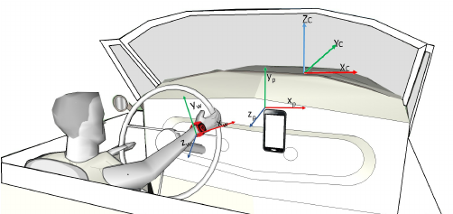
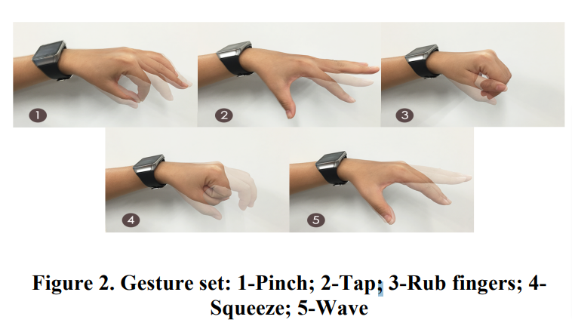
Smart Watches
Features:
Less powerful than a phone, but still pretty decent
WiFi/BLE, some with cellular/GPS module
Motion sensor (better way to capture your movements and gestures [CHI’16])

Slide 32
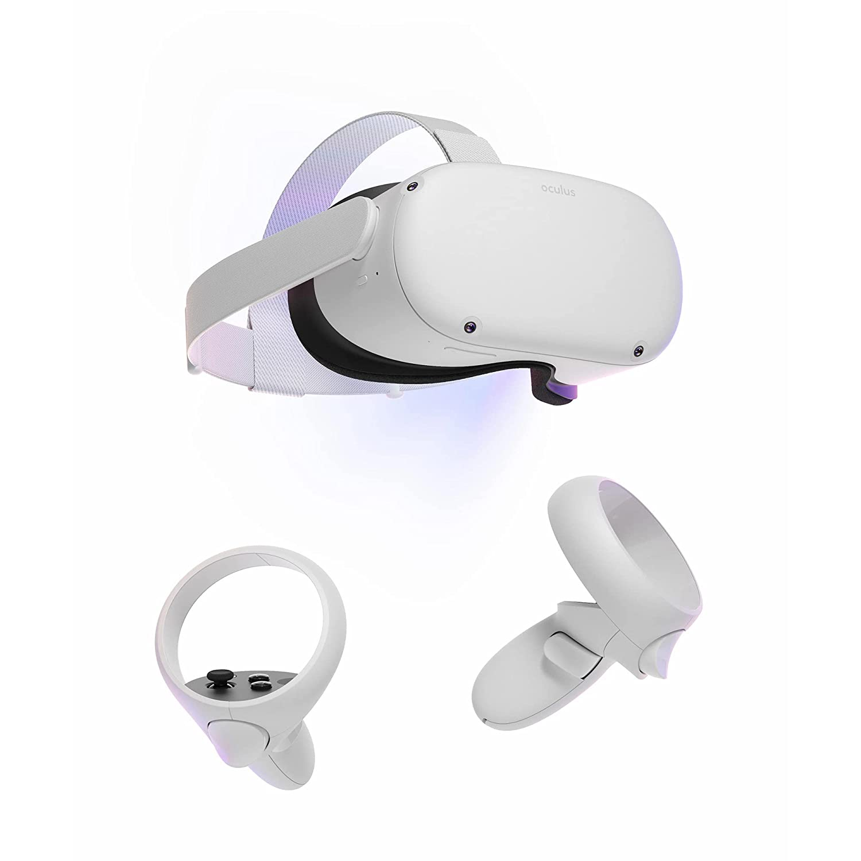
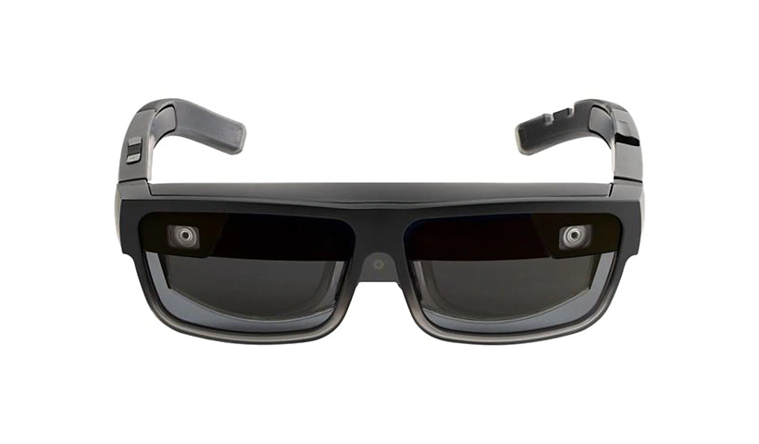
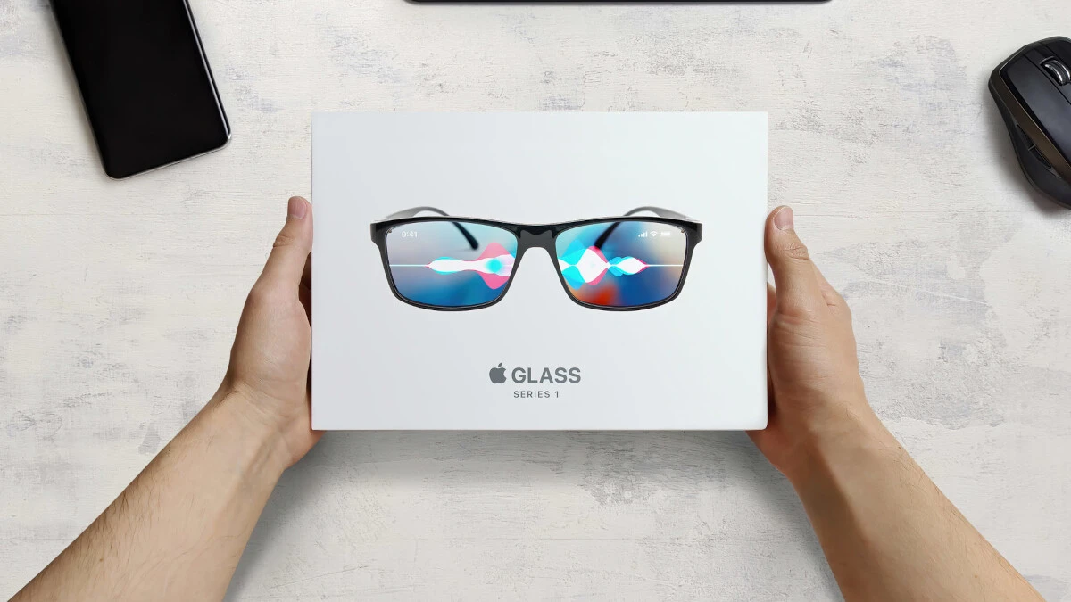
Smart Glasses
Smart Glasses: Google Glasses, Lenovo ThinkReality A3 (released in 2021)
Gaming Device: Oculus

Slide 33
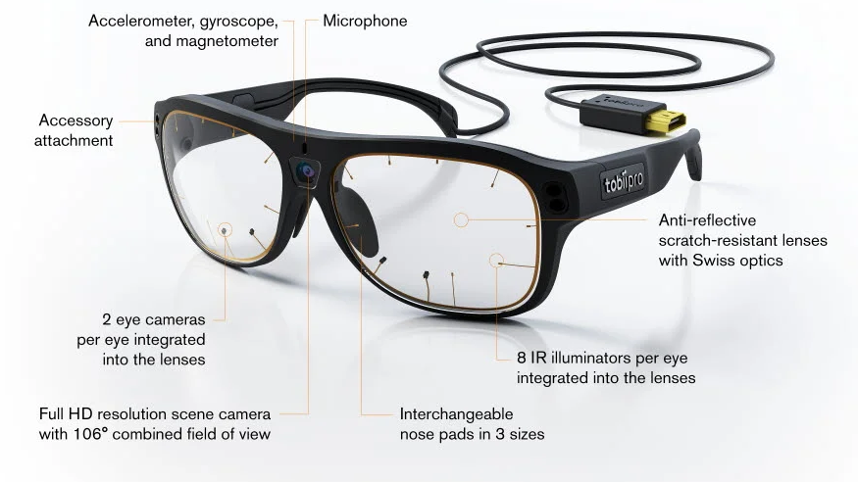
Smart Glasses
Sensors
Eye cameras: capture user eye movement
Motion sensors
Microphone
Scene camera
Feedback:
Display
bone conduction speaker
Photo source: www.tobiipro.com

Slide 34

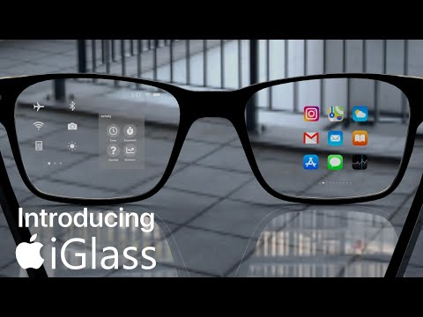
2023 will be the year of AR glasses ?
https://thenextweb.com/news/2023-year-ar-glasses-what-to-expect
Google, Meta, Apple, Microsoft (laid off recently-_-#)

Slide 35
Vehicle as a mobile sensor
Vehicle Status Sensing
Environmental Sensing
Driver (passenger) Sensing

Slide 36
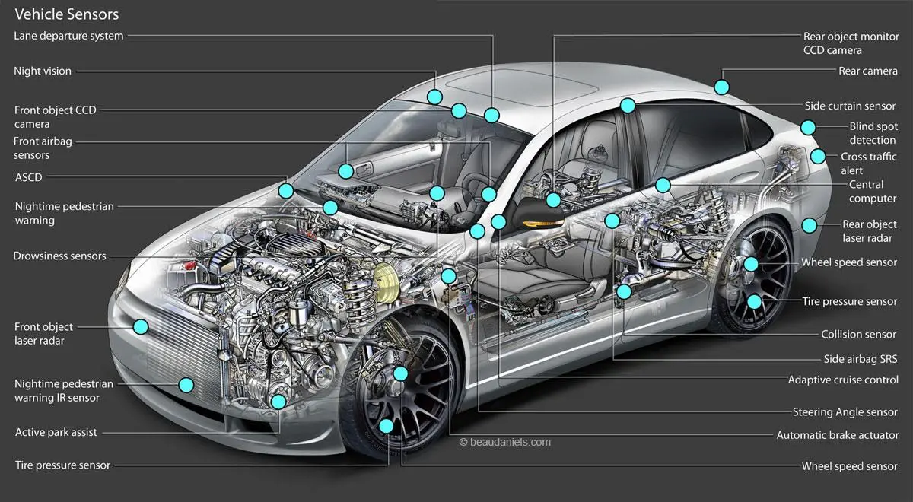

Slide 37
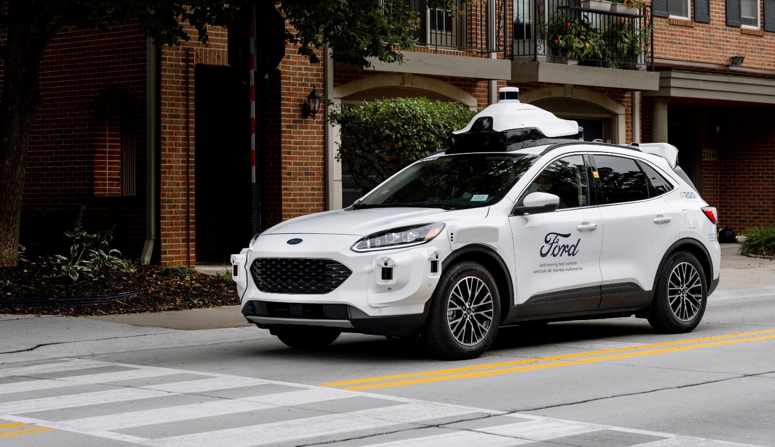
Sensors:
LiDAR (128 beam)
Camera
Radar
Driving information:
Speed;
Location;
Vibration sensors
…
Driver Monitoring:
Camera
Smart wheel
https://medium.com/self-driven/how-fords-next-gen-test-vehicle-lays-the-foundation-for-our-self-driving-business-aadbf247b6ce

Slide 38
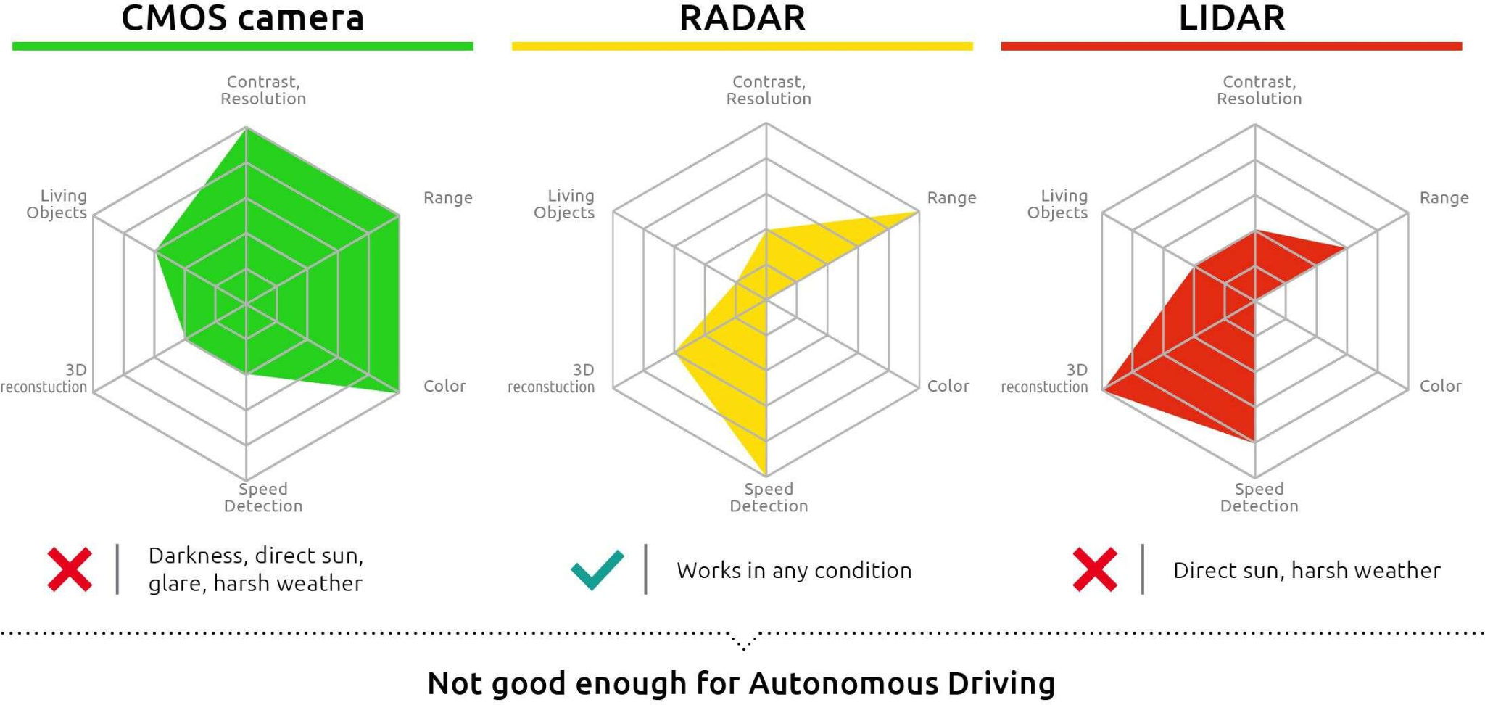
Why so many sensors?
https://www.embedded.com/why-fir-sensing-technology-is-essential-for-achieving-fully-autonomous-vehicles/

Slide 39
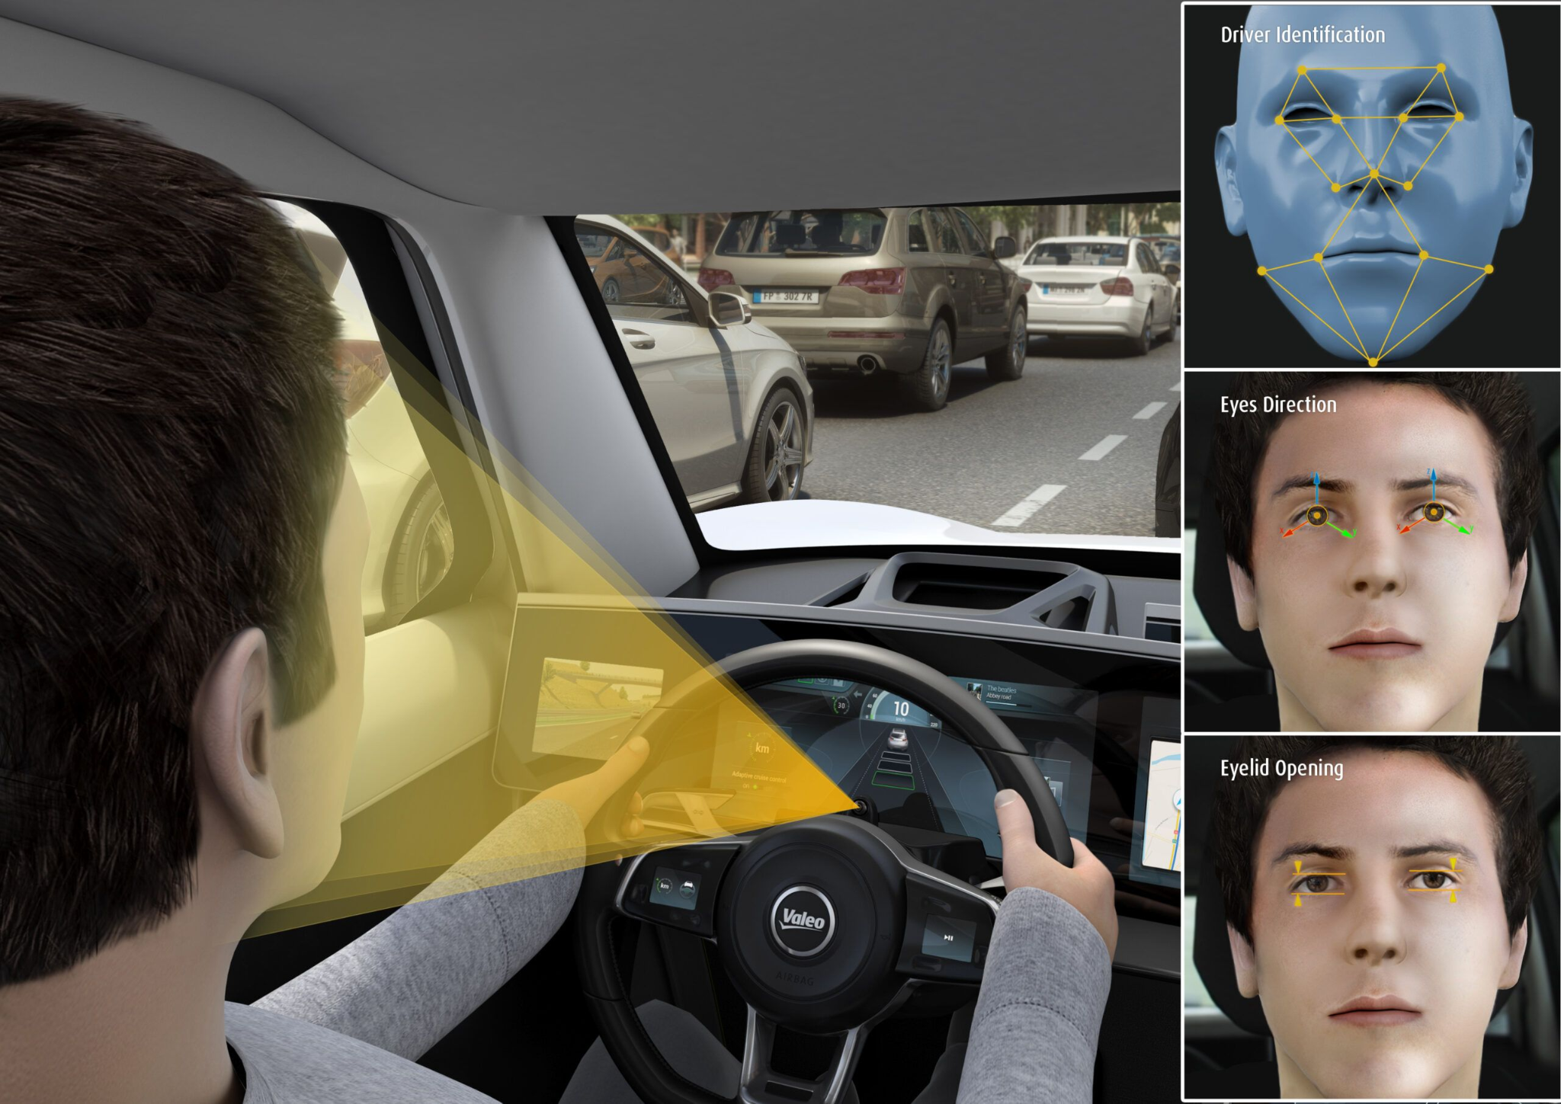


Slide 40
Outline
End Devices (data producers):
Common features
Raspberry Pi, Arduino, ESP32, Jetson TX2 NX
mobile devices
Vehicle as a mobile sensor
IoT Gateway
IoT Communication Protocols
BLE, Zigbee
MQTT, coAP, websocket
IoT applications:
indoor localization
smart home applications
wireless sensor network

Slide 41

Standard IoT Architectures
IoT nodes → Gateway → Cloud
Gateway: stationary plugged-in device
Other architectures? Infrastructureless (WiFi Direct)

Slide 42

Smart Home Devices
Diverse devices

Slide 43

Smart Home Devices
Smart Home Hubs: the brain of the smart home

Slide 44

How do these hubs work?
Ideally: hubs providing computing and storage capabilities

Slide 45

How do these hubs work?
Reality:
Echo is only a speaker and microphone with internet connection

Slide 46

Smart Home Hubs Market Share
Your choice?

Slide 47

Alexa Workflow
Device control logics can be processed either by AWS lambda functions or on device manufacturer’s cloud (3rd party cloud server).

Slide 48

Let’s see an example:
How many senior detection methods given in the video? What are they? What are their limitations?
What is the method introduced in the video? Does it have any limitations?
Do you have any suggestions for future senior fall detection products?

Slide 49
Outline
End Devices (data producers):
Common features
Raspberry Pi, Arduino, ESP32, Jetson TX2 NX
smart home sensors and gateways
mobile devices
IoT Gateway
IoT Communication Protocols:
BLE, Zigbee, LoRA
MQTT, coAP
IoT applications:
indoor localization
Personal sensing
crowdsensing
wireless sensor network

Slide 50
IoT Communication Protocols
Physical Layer/Link Layer protocols (communication hardware)
Zigbee
Bluetooth Low Energy
LoRA
Application Layer Protocols (communication software)
MQTT
coAP

Slide 51

ZigBee
Varies network topology:
Used in industrial networks (WSNs)
Optimized for self-organized environments:
Interference detection and channel switching
Dynamic Rerouting
Asymmetric link
Ad-hoc On-demand Distance Vector Routing
What is distance vector?
Why distance vector (not link state?)
Notes:
Link Management: Each node maintains quality of links to neighbors. Link quality is used as link cost in routing
Asymmetric Link: Each node has different transmit power and sensitivity. Paths may be asymmetric.
Ad-hoc On-demand Distance Vector Routing ❑ On-demand ⇒ Reactive ⇒ Construct a route when needed ❑ Routing Table: Path is not stored. Only next hop. ⮚ Entry = <destination, next node, "sequence #" (timestamp)> ❑ Route Discovery: Flood a route request (RREQ) to all neighbors. Neighbors broadcast to their neighbors ❑ Request ID is the RREQ serial number. Used to discard duplicates. Source sequence # is a clock counter incremented when RREQ is sent. Destination sequence # is the most recent sequence from the destination that the source has seen. Zero if unknown

Slide 52

Bluetooth
2.4-2.5 GHz ISM radio band, up to 3 Mbps
master / clients devices (piconet):
master polls clients, grants requests for client transmissions
parked mode: clients can “go to sleep” (park) and later wakeup (to preserve battery)
Frequency hopping:
C
P
P
radius of
coverage
M
C
C
P
P
M
master device
client device
parked device (inactive)
C
P
Notes:
Multi-access: polling…
Up to 7 active clients, 255 parket clients.

Slide 53

Bluetooth Low Energy (BT4.x, 5.x)
40 Channels with 2MHz Spacing for Frequency hopping
3 channels reserved for advertising and 37 channels for data
Advertising channels specially selected to avoid WiFi interference
Two device types: peripherals and central
Non-connectable advertising: Broadcast data
Discoverable advertising: send data without connection (per request)
Implementation: generic attribute profile (each attribute has a 16bit UUID)
Notes:
Universally unique ID

Slide 54




LoRa, the most popular LPWAN Tech
LoRa: Long Range…
9 miles
50 kbps
10 years

Slide 55



Overview of LoRa
Multi-access Control: Pure Aloha
Notes:
KPN (The Netherlands), which announced the previously mentioned nationwide LoRa network in The Netherlands end June,
Proximus (Belgium), the incumbent operator which was known as Belgacom previously and promises nationwide LoRaWAN coverage in the country by end 2016,
Orange (France), which started with 18 urban areas in the first quarter of 2016 and is expected to offer nationwide coverage soon as well,
Bouygues Telecom (France), also promising nationwide LoRa coverage by end 2016 and offering IoT services with its subsidiary company Objenious.
Unidata, an Italian telecom company, which announced the roll out of a LoRaWan network on June 14th. Initially this will be done in Rome with the promise of a full coverage of the city by 2017.
Netzikon, not a telecom firm but the name of a LoRaWan network which is present already in Stuttgart and will be rolled out nationwide in Germany by 2018 according to an October 4 press release by LPWAN provider Actility.

Slide 56

IoT Protocols
MQTT: Message Queuing Telemetry Transport
Publish, Subscribe (pub/sub)
Lightweight (based on TCP)
https://www.reddit.com/r/COVID.RSS
Notes:
tuh·leh·muh·tree

Slide 57
MQTT - Topic
A topic forms the namespace
Is hierarchical with each “sub topic” separated by a /
myhome/floor/room/temp
A subscriber can subscribe to an absolute topic or can use wildcards:
/Dearborn/TestRd/123/event
Event in Apt 123, Test Rd, Dearborn
/Dearborn/TestRd/+/event
Events happens in all apts in TestRd in Dearborn
/Dearborn/TestRd/123/#
All information (event, alarm) in apt 123 TestRd, Dearborn

Slide 58


Use on Constrained Networks
Protocol compressed into bit-wise headers and variable length fields.
Potential privacy issue?

Slide 59

Use on Constrained Networks
“Last will and testament” (LWT): reliability
Notes:
MQTT IS BASED ON TCP

Slide 60

Use on Constrained Networks
Provides multiple message delivery options

Slide 61
MQTT for Request/Response
Asynchronous bidirectional “push” delivery of messages to applications (no polling)
1) Client
- subscribe topic "function-xyz/response/<id>" //note: <id> is a client unique ID
2) Server
- subscribe topic "function-xyz/request/+" //note: "+" is a wildcard
3) Client
- publish topic "function-xyz/request/<id>" payload <input parameter>
4) Server
- receive notification "function-xyz/request/<id>" payload <input parameter>
- retrieve <id> from string
- process function-xyz(<input parameter>)
- publish topic "function-xyz/response/<id> " payload "<response>"
5) Client
- receive notification "function-xyz/response/<id>" payload "<response>"

Slide 62
Try it for yourself?
Mosquitto： open source message broker that implements the MQTT protocol versions 5.
Test server:
2. Run mosquitto server on your own PC
Compared with http (on 3G network android)
93x faster throughput
11.89x less battery to send
8x less network overhead
mosquitto_sub -h test.mosquitto.org -t "hello/world" –v
mosquitto_pub -h test.mosquitto.org -t "hello/world" -m "Who's there"

Slide 63

CoAP
Constrained application protocol
Lightweight HTTP (RESTful)
UDP with reliability enhancement:
Resource discovery

Slide 64
Light-weight HTTP
Same:
Request Methods: GET, POST, PUT, DELETE. (OBSERVE: subscribe to changes)
Response Methods: 2.xx (success), 4.xx (client error), 5.xx (servererror).
RESTful URI:
e.g., coap://homegateway:port/sensor/light
More information about RESTFUL: https://www.ibm.com/cloud/learn/rest-apis

Slide 65

Light-weight HTTP
Different:
Binary header:
HTTP, text-based
Request / Response share the same ID (like DNS)
https://tools.ietf.org/html/rfc7252

Slide 66

UDP-based
Message types:
Request: Confirmable, Non Confirmable,
Response: Acknowledgement and Reset
Example:

Slide 67

UDP-based Reliability Enhancement
Confirmable Message Upon Message Lost:

Slide 68

CoAP Resource Discovery
A well-known resource is used to discover other resources.

Slide 69
Outline
End Devices (data producers):
Common features
Raspberry Pi, Arduino, ESP32, Jetson TX2 NX
smart home sensors and gateways
mobile devices
IoT Gateway
IoT Communication Protocols:
BLE, Zigbee
MQTT, coAP, websocket
IoT applications:
indoor localization
Personal sensing
crowdsensing
wireless sensor network

Slide 70

Indoor Localization
GPS:
Works well in open area such as getting direction while driving
However, Fail or not work efficiently indoor area for instance inside large shopping mall due to obstacles
Solution: indoor positioning system

Slide 71

WHAT IS INDOOR LOCALIZATION?
a process of tracking or detecting a object or a devices in the indoor environment using various technology and techniques such as Wi-Fi based Fingerprint approach (commonly used)

Slide 72



Location-based Service (LBS)
Maps & Navigation:
Tracking Services:
Friends & family finder
Traffic (Museum)
Vehicle tracking
Information Services:
Local Search
Social networking
Context advertising
Gaming:
Layar

Slide 73

Lots of Technologies
Wireless-based solution
Sensor-based solution
Multi-source fusion

Slide 74

Wireless Signals for Localization

Slide 75


What features of the wireless signal to use?
•Received Signal Strength Indicator (RSSI)
•Channel State Information (CSI)
•Fingerprinting/Scene Analysis
•Angle of Arrival (AoA)
•Time of Flight (ToF)
•Time Difference of Arrival (TDoA)
•Return Time of Flight (RToF)
•Phase of Arrival (PoA)

Slide 76


Theoretical Foundation
Free Space Path Loss:
Transmitter and receiver in free space
Measured by: transmitted power – received power
Low accuracy in real environments
Notes:
Second is the white space path loss model. White space means that there are no obstructing objects between the transmitter and the receiver. Pass loss can be measured by the difference between transmitted power at the sender and the received power at the receiver. What it says is that path loss is related to distance and radio signal frequency. Higher frequency level of the wireless radio and longer distances cause higher pass loss.
So when we want to improve the bandwidth of wireless communication, what we can do is to, first, raise the sending power. second, shorten the transmission distance, and then use a lower frequency. That’s one of the reason why wireless communication starts from using low frequencies. Like the original radio network, broadcast network, and voice phone network they all use frequencies lower than 1GHz. Now, the low frequency channels have been almost fully occupied. That’s why we move on to 5G. We communicate using higher frequencies so we can have wider radio channel ranges. To compensate the path loss, we deploy more cell towers to reduce the transmission distances.
One may wonder why cannot we increase the sending power. It is because our phones need to be senders as well and they are powered by batteries.

Slide 77


Fingerprint
Offline training & Online matching

Slide 78
Sensor Based IPS
Sensors:
Camera
Surveillance
Phone camera
light-based
IMU (inertial measurement unit)
Odometry (robot)
Techniques:
Image processing
Dead reckoning

Slide 79

Camera based indoor positioning
Mobile camera: heavy data collection and training
Surveillance camera: when applied in a public place with a lot of people
What is one is blocked by others?
Privacy issue
How to associate user’s movement with their identity

Slide 80

IMU based Positioning
Smart phone:
Quite accurate in counting steps
Not so good at detecting moving directions

Slide 81
Indoor positioning systems
Joint usage of multiple technologies
Tradeoff between accuracy / deployment & Training cost
Some papers to read if you are interested:
Push the limit of WiFI based localization for smartphones
SpotFi: Decimeter level localization using WiFi

Slide 82

My first research project

Slide 83

Correction Points

Slide 84

Experiment

Slide 85

Result

Slide 86
Personal Sensing
Activity recognition: aims to recognize the actions and goals of one or more agents from a series of observations on the agents' actions and the environmental conditions.
computer takes raw data as input and recognizes the user’s motion activity

Slide 87

Activities
Simple activities: walking, sitting, standing, talking elevators…
Complex activities: shopping, smoking, driving, eating

Slide 88

Process of activity recognition
Sensors:
Video sensors
Fixed location
May have privacy problem
Environmentmental sensors
WiFi, Bluetooth, Infrared sensors
Fixed location, limited inform
Wearable sensors:
Equipped on human body
Smart phones

Slide 89

Data Collection
Start from scratch

Slide 90


Applications
Recommended readings:
I am a Smartwatch and I can track my User’s Arm (gesture recognition)
Recognizing Smoking Gestures with Inertial Measurements Unit
Your Glasses Know Your Diet: Dietary Monitoring using Electromyography Sensors
Contactless Sleep Apnea Diagnosis on Smartphones(acoustic reflection)
E-eyes: Device-free Location-oriented Activity Identification Using Fine-grained WiFi Signatures
understanding and modeling of wifi signal based human activity recognition
Motion Tracking via Radio Reflections off the Body (WiTrack, see through the wall)
EQ-Radio: Emotion Recognition using Wireless Signals (vital signs)

Slide 91
CrowdSensing
Crowdsensing, sometimes referred to as mobile crowdsensing, is a technique where a large group of individuals having mobile devices capable of sensing and computing (such as smartphones, tablet computers, wearables) collectively share data and extract information to measure, map, analyze, estimate or infer (predict) any processes of common interest. In short, this means crowdsourcing of sensor data from mobile devices.
Participatory sensing: individuals are actively involved in contributing sensor data
Opportunistic sensing: user involvement is minimal

Slide 92


Crowd-Sensing for On-street Smart Parking
Objective: searching for free parking spots
1) infrastructure-based approaches; 2) users input

Slide 93


Crowd Sensing based Traffic Detection
Apple/Google Map

Slide 94


Wireless Sensor Network
Features:
Sensors: battery-supported, sensing and communication (data relay)
No backbone infrastructure or centralized control
Sensitive to Energy Consumption/Latency/reliability
Multi-hop self-organized mesh network:

Slide 95


Building Monitoring / Intrusion Detection
Story about Shanghai Airport

Slide 96


Zebranet
Purpose: track zebras on the field
Solution: GPS + Wireless Communication
ASPLOS'20 - ASPLOS Most Influential Paper Award https://www.youtube.com/watch?v=5c0IhQ07Hfo

Slide 97


Delay Tolerant Network
Store, Carry, and Forward
Usages: disaster response

Slide 98

Basic Research Challenges:
Routing (Flooding) with Intermittent Connectivity

Slide 99
What is IoT?
A network connecting (either wired or wireless) devices, or ‘things’, that is characterized by autonomous provisioning, management, and monitoring.
IoT is the next evolution of the Internet, connecting the unconnected people, processes, data, and things in your business today (Cisco)
IoT devices as those capable of two-way data transmission (excluding passive sensors and RFID tags). It includes connections using multiple communication methods such as cellular, short range and others. (GSMA)
Sensors & actuators connected by networks to computing systems. These systems can monitor or manage the health and actions of connected objects and machines. Connected sensors can also monitor the natural world, people, and animal” (McKinsey)

Slide 100
What is IoT? (IEEE Internet of things journal)
“An IoT system is a network of networks where, typically, a massive number of objects, things, sensors or devices are connected through communications and information infrastructure to provide value-added services via intelligent data processing and management for different applications (e.g. smart cities, smart health, smart grid, smart home, smart transportation, and smart shopping).”

Slide 101
If you are interested in IoT-related research
MobiSys, Sensys, MobiCOM
PerCOM
Ubicomp
https://www.youtube.com/watch?v=ULfg9MV4ymQ

